Slide 1
Date: 2012/08/21
Source: Zhong Zeng, Zhifeng Bao, Tok Wang Ling, Mong Li Lee (KEYS’12) Speaker: Er-Gang Liu
Advisor: Dr. Jia-ling Koh

Slide 2
Outline
Introduction
Proposed Framework
Overview
Keyword Node Detection
Keyword Node Combination
Interpretation Generation
Interpretation Ranking
Keyword semantics confidence
Connected structure confidence
Experiment Plan
Conclusion

Slide 3
Outline
Introduction
Proposed Framework
Overview
Keyword Node Detection
Keyword Node Combination
Interpretation Generation
Interpretation Ranking
Keyword semantics confidence
Connected structure confidence
Experiment Plan
Conclusion

Slide 4
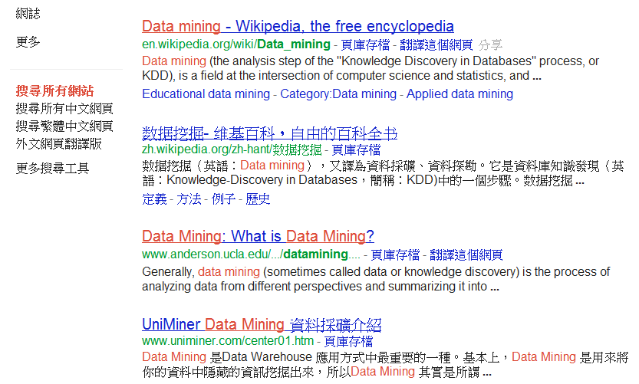
Motivation
Ranking
Text documents:
Unstructured
Accessed by keywords
Large user population

Slide 5
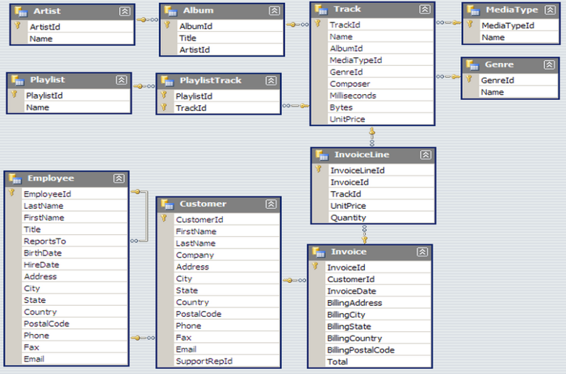
Motivation
Database
Easy to use
Increasing the DB usability
Enabling interesting and unexpected discoveries

Slide 6
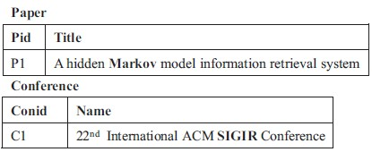
Goal
Phase 1
Phase 2
Phase 3
System takes a keyword query as input
Generates a set of possible interpretations sorted by their relevance to the query
Generated interpretations are presented to the user
User can choose which interpretation(s) best match his/her search intention
System translates the selected interpretations into a set of SQL queries
Retrieving the results.

Slide 7
Outline
Introduction
Proposed Framework
Overview
Keyword Node Detection
Keyword Node Combination
Interpretation Generation
Interpretation Ranking
Keyword semantics confidence
Connected structure confidence
Experiment Plan
Conclusion

Slide 8
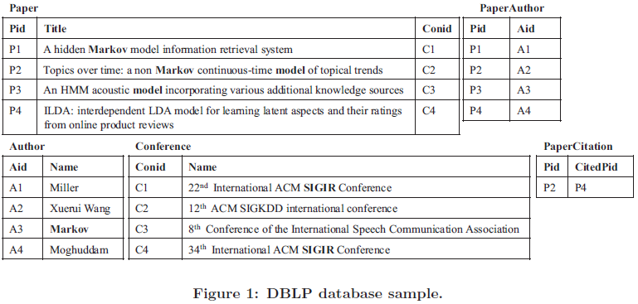
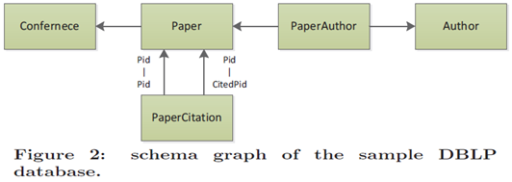

Slide 9
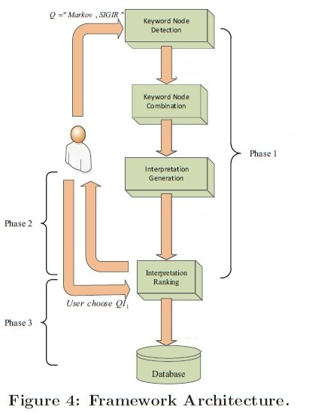

Slide 10
Outline
Introduction
Proposed Framework
Overview
Keyword Node Detection
Keyword Node Combination
Interpretation Generation
Interpretation Ranking
Keyword semantics confidence
Connected structure confidence
Experiment Plan
Conclusion

Slide 11
Keyword Node Detection
Paper title
Author name
Conference name
Figure out all the semantics of each keyword in the query
Notes:
為了找出所有可能 與查詢字有關 interpretation. 找出Keyword 所有可能代表的意思

Slide 12
Outline
Introduction
Proposed Framework
Overview
Keyword Node Detection
Keyword Node Combination
Interpretation Generation
Interpretation Ranking
Keyword semantics confidence
Connected structure confidence
Experiment Plan
Conclusion

Slide 13
Keyword Node Combination
All possible combinations
Combination
Taking all the sets of keyword nodes and generate all possible combinations of keyword nodes from each set.
Notes:
每一個組合 代表一種語意關係. 產生所有種的組合.

Slide 14
Outline
Introduction
Proposed Framework
Overview
Keyword Node Detection
Keyword Node Combination
Interpretation Generation
Interpretation Ranking
Keyword semantics confidence
Connected structure confidence
Experiment Plan
Conclusion

Slide 15
Interpretation Generation
a “Markov” paper cites another paper
which is accepted in conference “SIGIR”.
QI₁
QI₂
a paper whose title contains “Markov” is accepted in conference “SIGIR”;
Processing inputs each combination of keyword nodes and finds a set of connected graphs of relations that link all the keywords.
Notes:
how to generate interpretations of the query
兩者所代表的語意關係不同. 所以會找出所有可能語意關係的表示

Slide 16
Outline
Introduction
Proposed Framework
Overview
Keyword Node Detection
Keyword Node Combination
Interpretation Generation
Interpretation Ranking
Keyword semantics confidence
Connected structure confidence
Experiment Plan
Conclusion

Slide 17
Interpretation Ranking
Keyword semantics confidence
Connected structure confidence
Guideline 1: The more tuples match the keyword with some semantics.
Guideline 2: The more discriminative the keyword is across the relation.
Guideline 3: The more important the relation.

Slide 18
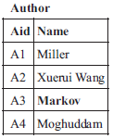
Keyword semantics confidence
Indicating that a query keyword tends to refer to the semantics with many tuples that contain the keyword and match that semantics.
N_{Ri‧aj} (k) : number of tuples in R_{i} that contain k in attribute A_{j}
N_{”Paper”‧”Title”} (Markov) =2
Score (“Paper” , “Title”, “Markov)
= $\frac{2}{2+1}$= $\frac{2}{3}$
N_{”Author”‧”Name”} (Markov) =1
Score (“Author” , “Name”, “Markov)
= $\frac{1}{2+1}$= $\frac{1}{3}$

Slide 19
Keyword semantics confidence
Reducing the confidence of keyword referring to the attribute of relation with the increasing number of tuples that contain keyword in attribute
N_{Ri} : number of tuples in R_{i}
N_{”Paper”}=4
Score (“Paper” , “Title”, “Markov) = ln ‧ $\frac{4+1}{2}\text{=}$ ln $\frac{5}{2}$
N_{”Author”}=4
Score (“Author” , “Name”, “Markov) = ln ‧ $\frac{4+1}{1}$ = ln 5

Slide 20
Keyword semantics confidence
Im(Ri) represents the importance of relation, it is set by experts.

Slide 21
Keyword semantics confidence
Penalize the attribute length since longer attribute values have a larger chance to contain the keyword.
dl(k) : average size of attribute values of tuples that contain k in R_{i}
avdl : average size of attribute values of all tuples in R_{i}
s1 : a constant
dl(Markov) = $\frac{7+11}{2}\text{=}$ 9
Score (“Paper” , “Title”, “Markov) = $\frac{1}{1−0.5 +(0.5∗\frac{9}{10.5})}\text{ =}$ $\frac{1}{0.93}$
Score (“Anthor” , “Name”, “Markov) = $\frac{1}{1−0.5 +(0.5∗\frac{1}{1})}\text{ =}$ 1
avdl = $\frac{7+11+9+15}{4}\text{=}$ 10.5

Slide 22
Outline
Introduction
Proposed Framework
Overview
Keyword Node Detection
Keyword Node Combination
Interpretation Generation
Interpretation Ranking
Keyword semantics confidence
Connected structure confidence
Experiment Plan
Conclusion

Slide 23
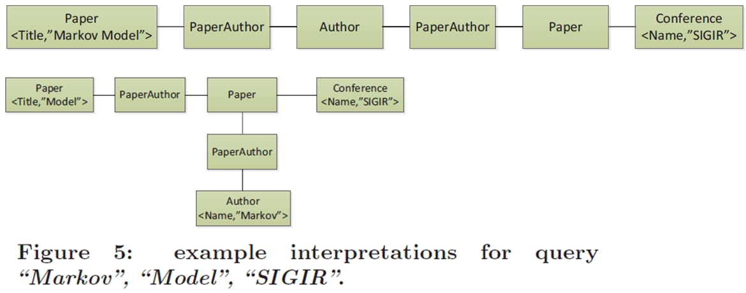
Connected structure confidence
Connected structure confidence
The larger size of the interpretation, the less useful it tends to be
The more cohesive the keywords are in the query interpretation, the more useful it tends to be.
$Score\left(QI\right)= \sqrt{1−(\frac{6−1}{6})}$²

Slide 24
Interpretation Ranking
QI_{a}
QI_{b}

Slide 25
Outline
Introduction
Proposed Framework
Overview
Keyword Node Detection
Keyword Node Combination
Interpretation Generation
Interpretation Ranking
Keyword semantics confidence
Connected structure confidence
Experiment Plan
Conclusion

Slide 26
Experiment Plan
Data Set
Internet Movie Database(IMDB), where around 200,000 movies of recent years are selected in our dataset
DBLP , which contains publications since 1990.
Query Set
Setting 18 queries for each of the datasets.
Dividing these queries into three clusters: short queries (2 or 3) keywords, medium queries (4 or 5) and long queries with 6.

Slide 27
Experiment Plan
Processing Time
Run 10 times and collect the average processing time.
Compare two processing
Paper Algorithm
Search Engine
Quality of the Query Interpretations
The participants are asked to score the quality of each query interpretation (from 0 to 5 points, 5 means best while 0 means worst)

Slide 28
Outline
Introduction
Proposed Framework
Overview
Keyword Node Detection
Keyword Node Combination
Interpretation Generation
Interpretation Ranking
Keyword semantics confidence
Connected structure confidence
Experiment Plan
Conclusion

Slide 29
Conclusion
Query interpretation is a critical issue in keyword search over relational databases that has yet received very little attention.
This paper proposed a 3 phase keyword search paradigm that focused on query interpretation generating and ranking.
Analyzing the challenges to rank all the interpretations and proposed some guidelines to compute the confidence of an interpretation to be the user desired.

